Slide 1
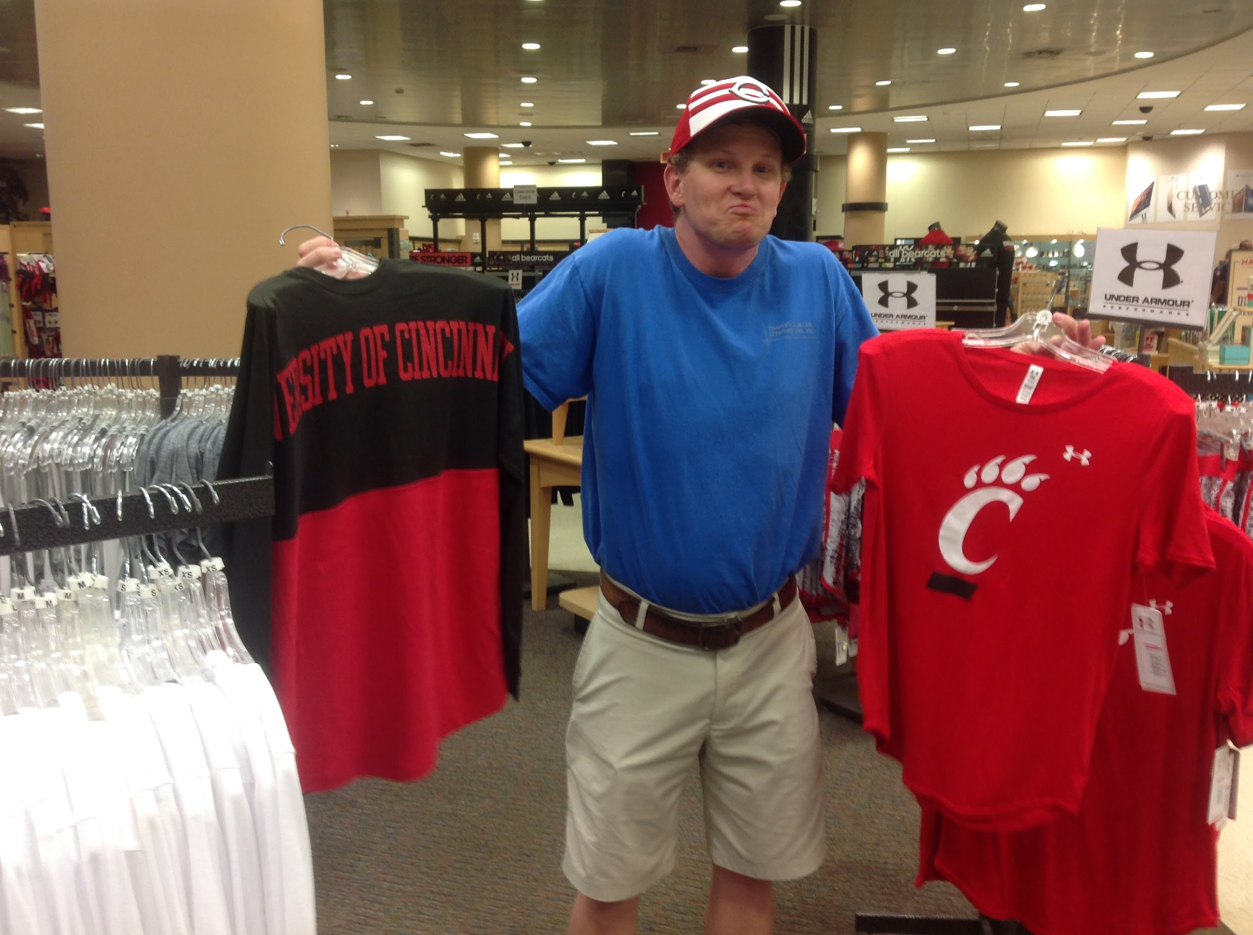
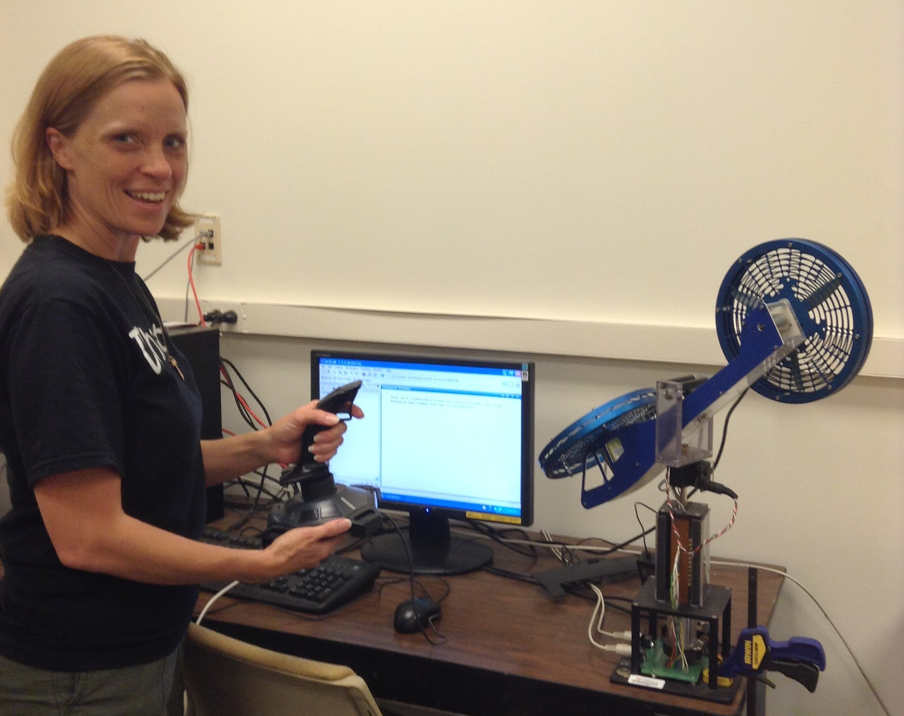
Optimization and Bio-Inspired Decision Making
EEC-1404766
Dustin Hinson, Newport MS
Marcia Roth, Catholic Central HS
RET 2015

Slide 2
Table of Contents
Introduction
What is Optimization
Is the TSP really that difficult?
Why does this matter?
Applications for the TSP
Research goals
Research instruments and training
Results
2-opt
Genetic Algorithms
Hybrids
Instructional Units

Slide 3
The Team!
(From left to right)
Marcia Roth, RET teacher Catholic Central High
Dustin Hinson, RET teacher Newport MS
Anoop Sathyan, PhD. Student UC
Dr. Jeff Kastner, Assistant Professor UC
not pictured: Dr. Kelly Cohen, Professor UC

Slide 4
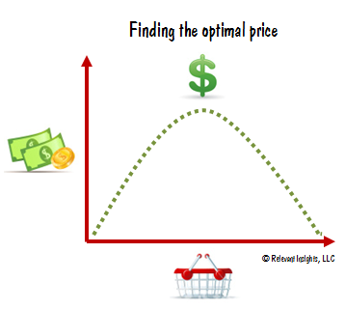
Optimization
The art and science of allocating scarce resources to the best possible effect
“Getting the most bang for our buck”
http://www.clickcentricseo.com/tag/optimization

Slide 5
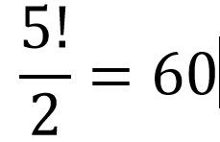
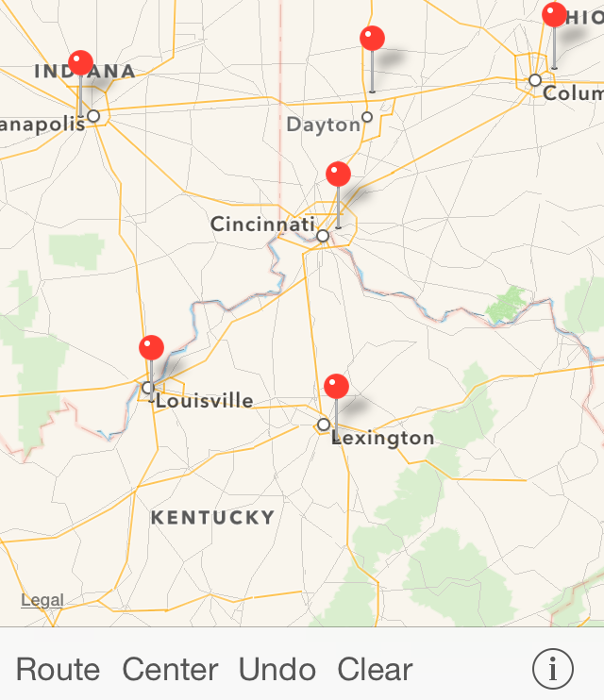
ConcordeTSP app
The Traveling Salesman Problem (Commonly known as the TSP.)
Apple maps

Slide 6
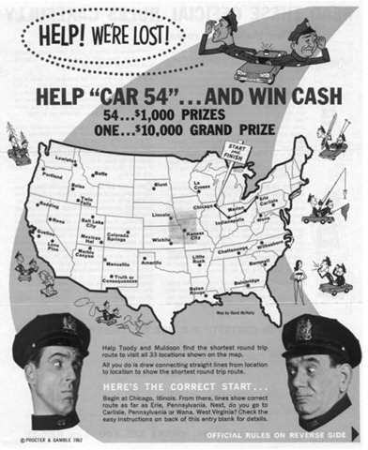
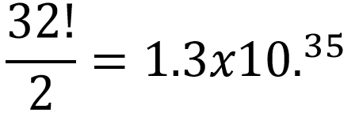
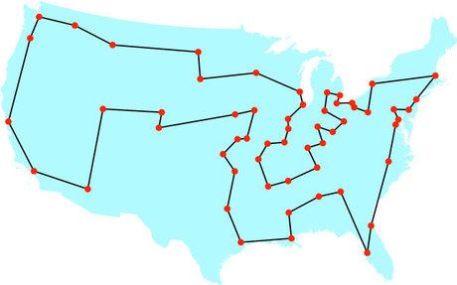
The Optimal Solution
Proctor and Gamble
Proctor and Gamble

Slide 7
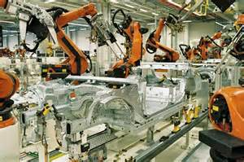
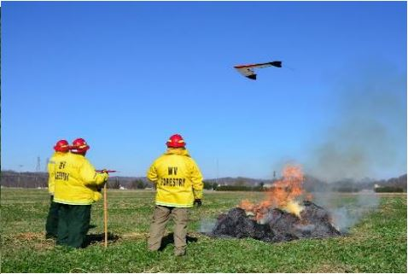
TSP – Applications, Career
Connections
Ups.com
Motortorque.com
Kari Greer photography
thenation.com

Slide 8
Optimizing Solutions for the TSP
Goal
Design and test a hybrid 2-Opt and Genetic Algorithm for solving the TSP in Matlab®.
Objectives
Matlab® Training, 2-Opt and GA June 16-26
Creating Hybrids June 29-July 2
Testing and Refining Hybrids July 6-21
Communicating Results July 22-30

Slide 9
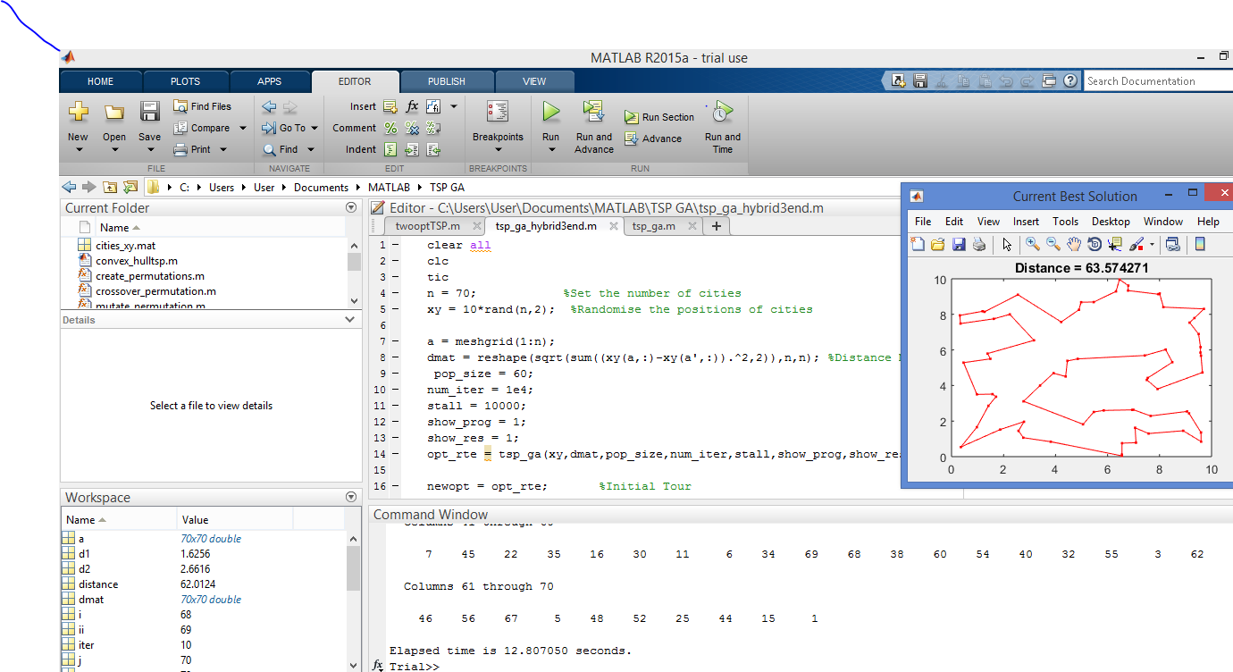
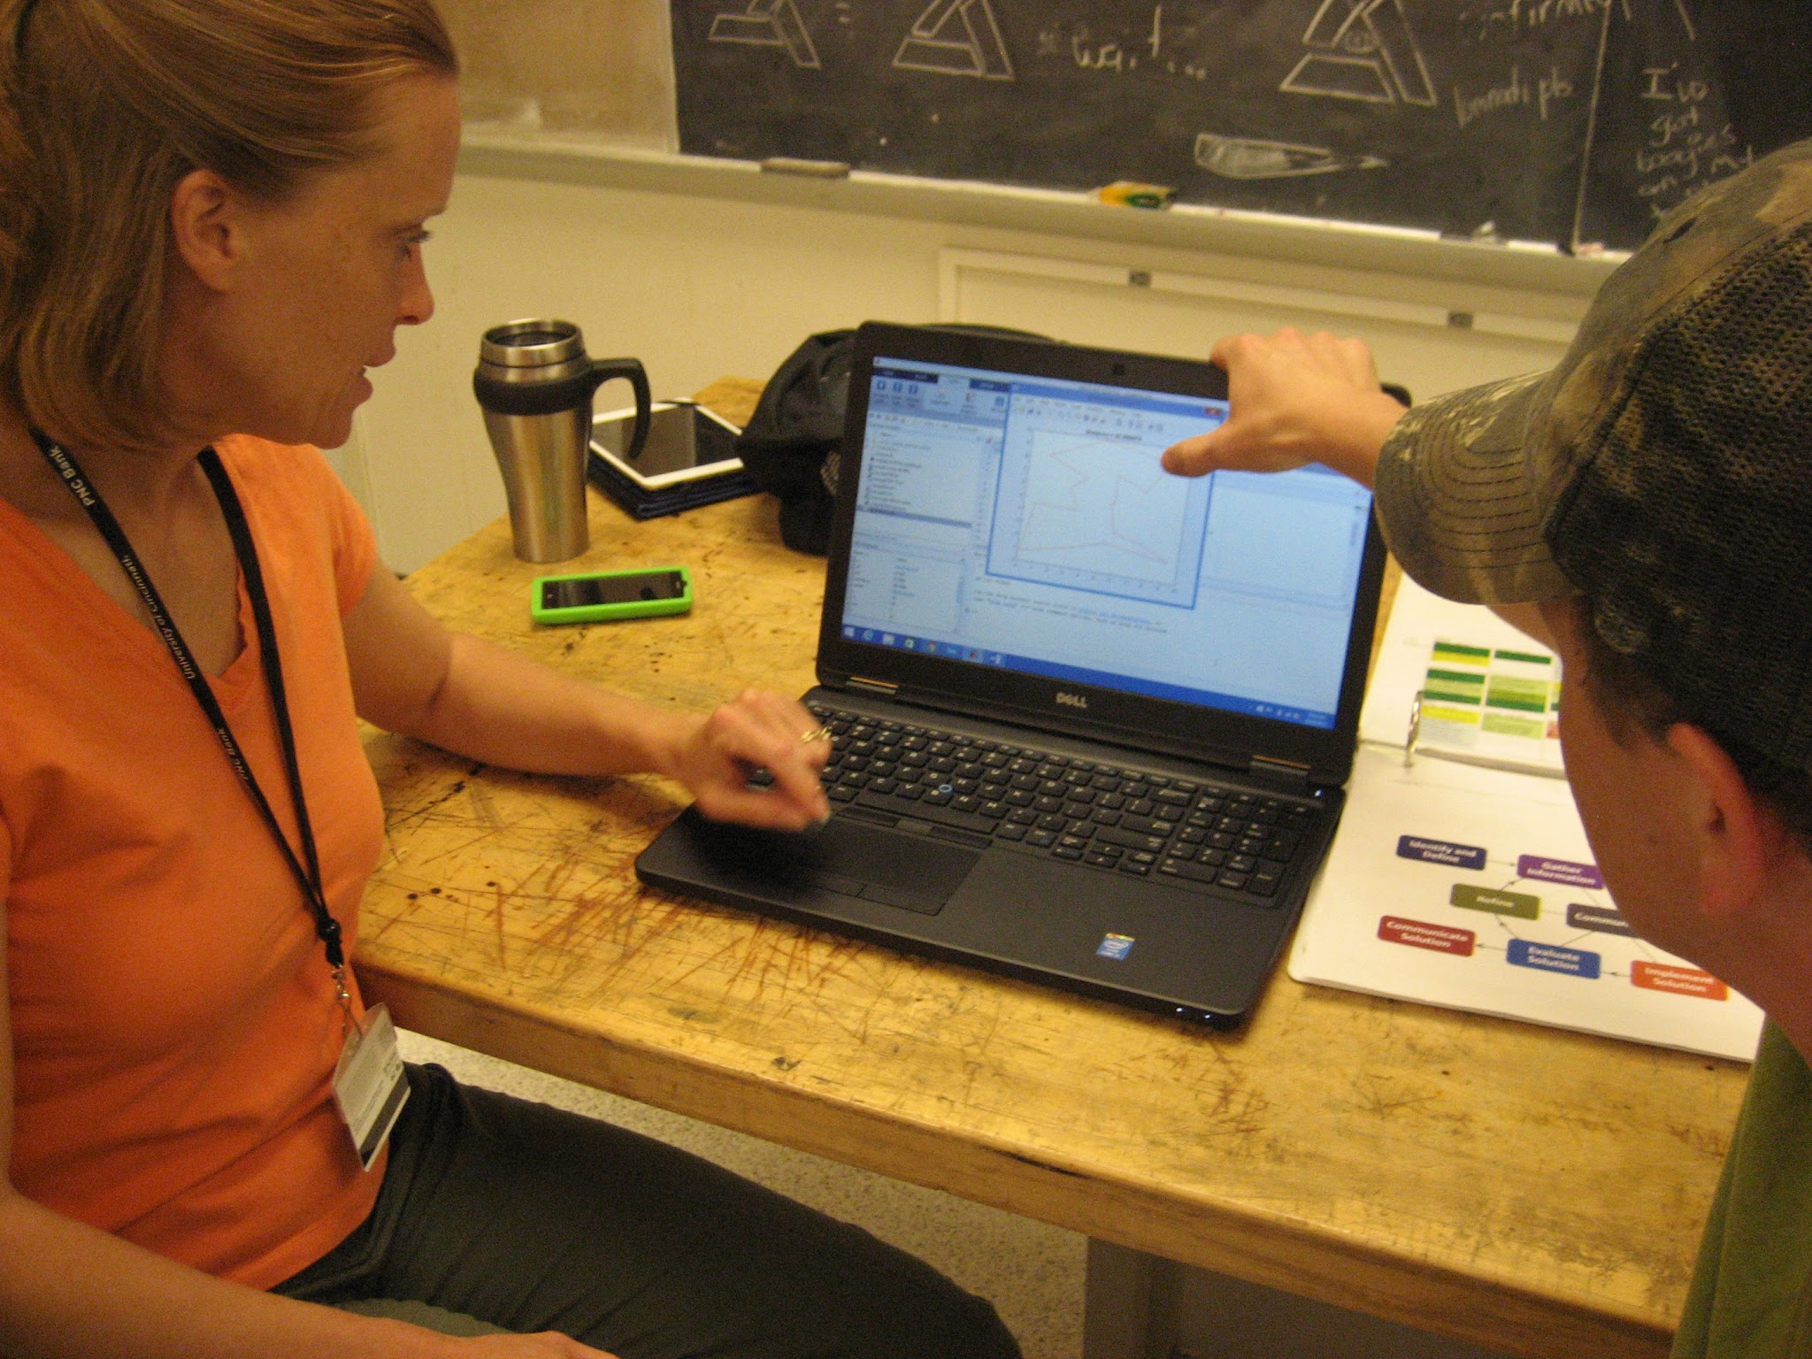
Matlab® Training
Matlab

Slide 10
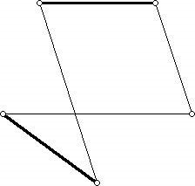
2-opt +Quick run time +Reasonably accurate +Compares line segments to determine if a switch would produce a shorter route
The 2-opt Algorithm
Ams.org

Slide 11
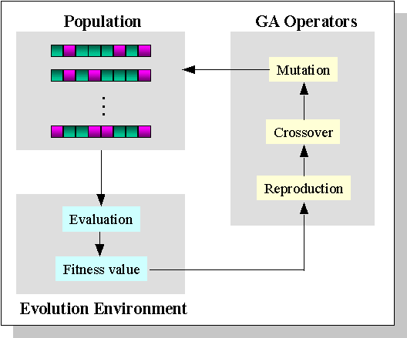
Genetic Algorithms
ewh.ieee.org
TSP Genetic Algorithm: Evolving the Solution
https://www.youtube.com/watch?v=bUEOuI2fK-M

Slide 12
Identify Alternatives:
Hybrid Models
Hybrid 1 (Front): 2-Opt creates one of the parents in the initial population for GA
Hybrid 2 (Middle): 2-Opt as one mutation during each GA generation
Hybrid 2b (Middle Short): 2-Opt mutates portion of parent tour during each GA generation
Hybrid 3 (End): 2-Opt the best outcome produced by GA

Slide 13
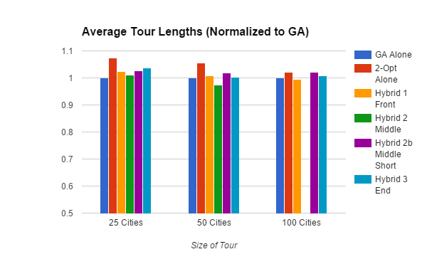
Testing and Evaluating Solutions:
Results: Population 60

Slide 14
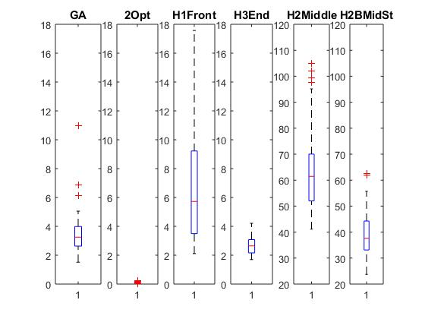
Results, Cont’d
100 Cities: Running Time (Seconds)

Slide 15
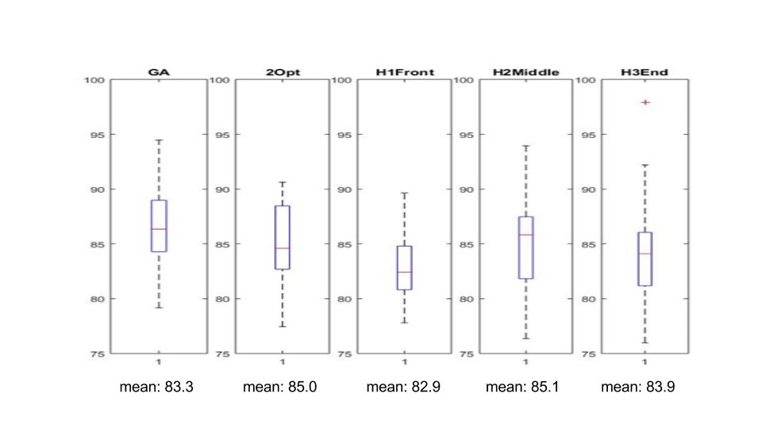
Results, Cont’d
100 Cities: Tour Distance

Slide 16
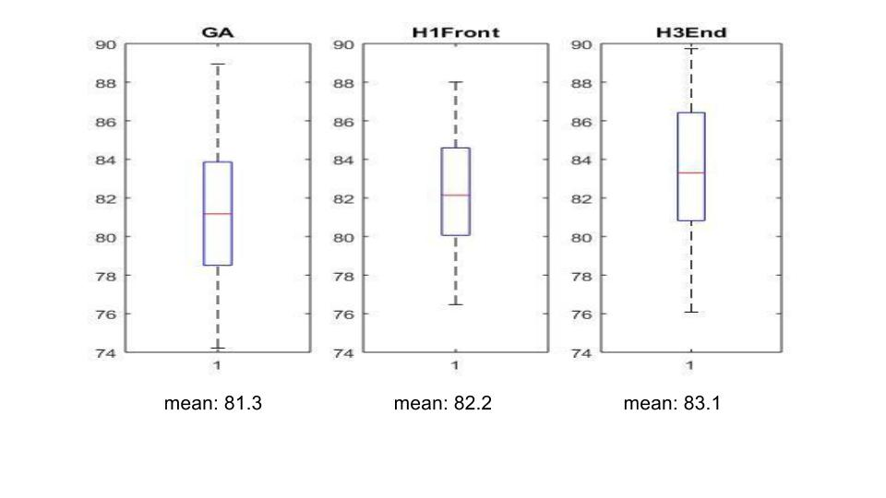
Results, Cont’d
Population 120
100 Cities, Tour Distance

Slide 17
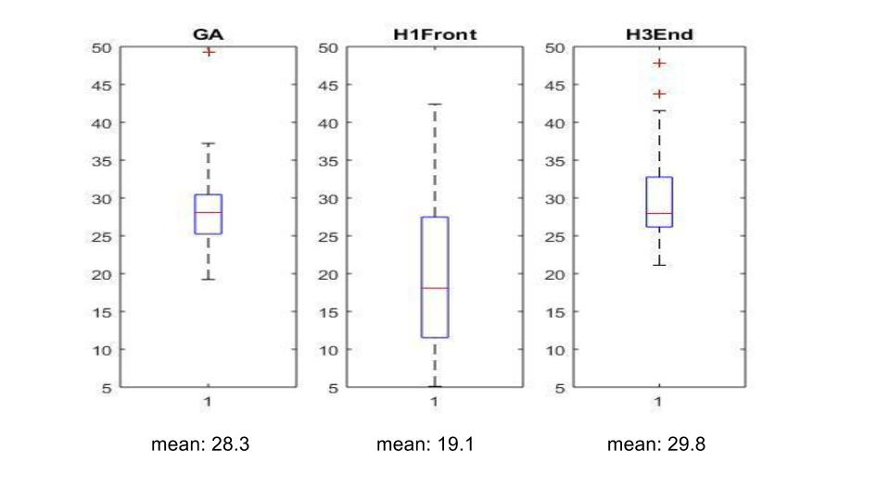
Results, Cont’d
Population 120
100 Cities, Running Time

Slide 18
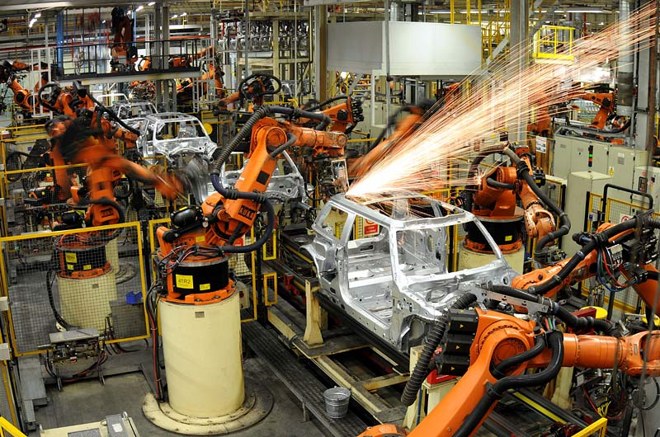
Conclusions
thenation.com
Motortorque.com
None of the hybrids consistently produced shorter tours than GA alone.
Specific applications would bring focus to future research
Hybrid 1 (Front) - shorter distance and time than GA?
Hybrid 2 (Middle) – shorter distance than GA,
long running times?
Future tests should use the same maps of cities for different hybrids

Slide 19
Unit Plan: Dustin
Essential Questions
What is optimization and how does it relate to the real world?
What resources do professionals use to produce the best possible product?
How do you know when an idea or object is optimized?
The Challenge- Students will design a t-shirt for sale as school spirit wear. They will be required to fully develop a business plan with supporting market research that supports the proposed design. Presentation of the business plan will serve as one of the summative assessments for the unit.

Slide 20
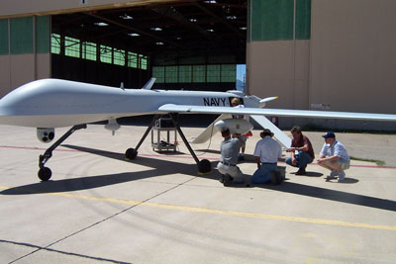
Unit Plan: Marcia
UAVs and Disaster Relief
Can we predict natural disasters before they happen?
Can we deliver relief supplies quickly and safely?
How do we decide who to help first?
What difference would a UAV make?
Gavin Gough, 2015
defense-update.com

Slide 21
Bibliography
Applegate,D. et al (2007). The Traveling Salesman Problem, Princeton University Press, Princeton, NJ.
Dianati, M., Song, I., and Treiber, M. (n.d.). 'An introduction to Genetic Algorithms and Evolution Strategies'.
Mitchell, M. (1996). An introduction to genetic algorithms. MIT Press, Cambridge, Mass.
Rajesh Matai, Murari Lal Mittal, and Surya Singh,. (2010). Traveling Salesman Problem: an Overview of Applications, Formulations, and Solution Approaches. INTECH Open Access Publisher.
Sabha, S., and Chikhi, S., (2012). “Integrating the Best 2-opt Method to Enhance the Genetic Algorithm Execution Time in solving the Traveler Salesman Problem.” Complex Systems and Dependability (195-208) Springer Berlin Heidelberg
Sakurai, Y., Tsuruta, S., Onoyama, T.; Kubota, S. (2009). “A multi-inner-world genetic algorithm using multiple heuristics to optimize delivery schedule.” IEEE International Conference on Systems, Man and Cybernetics, 2009, San Antonio, TX, p 605-610.
Sathyan, A., Boone, N., and Cohen, K. (2015). 'Comparison of Approximate Approaches to Solving the Travelling Salesman Problem and its Application to UAV Swarming'. International Journal of Unmanned Systems Engineering, 3(1), 1-16.
Snodgrass, P. (2013). 'Universities Aid Soaring Technology for Unmanned Aerial Vehicles'.Firehouse, 78-81.

Slide 22
Acknowledgements
Our work would not have been possible without the help from the following people. Thank You!
Debbie Liberi Dr. Anant Kukreti David Macmorine
UC Engineering: (Especially Anoop Sathyan, Dr. Jeff Kastner, and Dr. Kelly Cohen)
NSF Grant #EEC-140476 RET/CEEMS Programs
Genetic Algorithm Code Author: Joseph Kirk

